Slide 1
Micro-Electro-Mechanical Systems (MEMS) Based Sensing System for Soil Conditions Monitoring
http://sddec18-05.sd.ece.iastate.edu/
Client: Dr. Halil Ceylan
Advisers: Shuo Yang & Dr. Yang Zhang
Team: sddec18-05
Members: David Severson, Nathan Coonrod, Kyle Kehoe, Jacob Verheyen, Sok-Yan Poon
Notes:
Presenter: David with introduction

Slide 2
Project Plan
Notes:
Presenter: David. First we are going to talk about the aspects of our project plan on this project.

Slide 3
Problem Statement/Background
Currently, the CCEE department is using expensive, unreliable sensors for monitoring temperature and moisture content of soil. This project will create a low cost data acquisition system for the MEMS sensors designed by the ECpE department. The system will gather soil moisture and temperature data for up to one month, to be later used by the CCEE department for research purposes.
Notes:
Presenter: David

Slide 4
MEMS Sensors
Sensors are currently not functional
Designing system around assumed sensor values
Sensors will be fabricated next semester
Notes:
Presenter: David

Slide 5
Requirements and Specifications
Requirement | Implementation | Associated Test
Four independent sensor channels | Two temperature, two moisture channels | NA
One month data storage | Onboard micro SD card | Test 1A
Resistance measurement range 200-300 ohms | 100-400 ohms with 0.5 ohm accuracy | Test 2A
Capacitance measurement range 1-3pF | 0-4pF with 40fF accuracy | Test 3A
One month battery life in favorable conditions | Battery sized for average battery life of 1 month | Test 1B
15 minute sampling period | Adjustable sample period, default 15 minutes | Test 1C
Cable length of three feet | Meets requirements with 3ft sensor cables | NA
Notes:
Presenter David

Slide 6
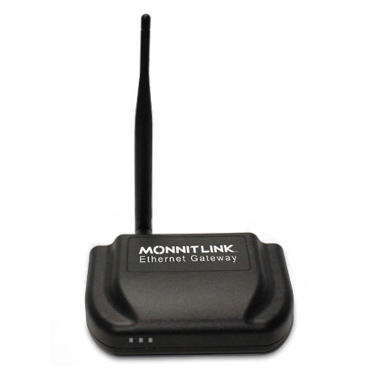
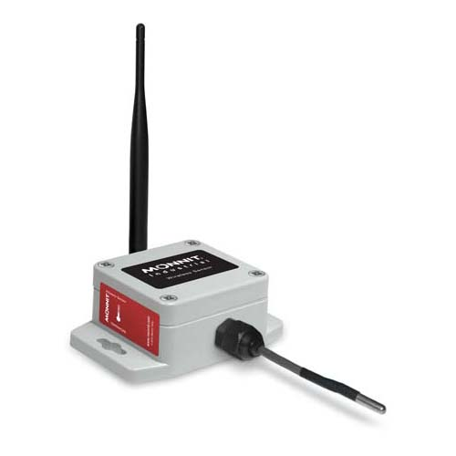
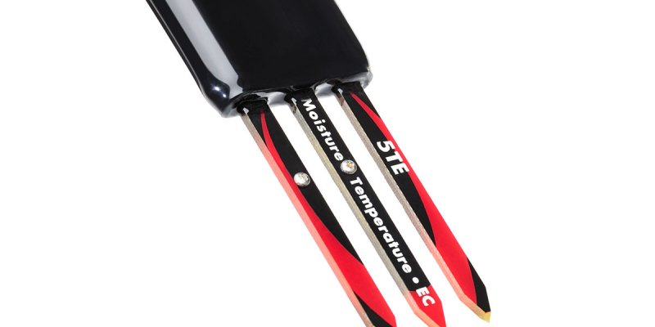
Current Systems in Use
Data Acquisition/Data Loggers | Associated Sensors | Total Cost
Data Acquisition Module | Temperature Sensor | $159 (per sensor) $230 (data acquisition module) $389 total
Data Acquisition Module | Soil Moisture & Temperature Sensor | $206 (per sensor) $750 (data acquisition module) $956 total
Notes:
Presenter David
Up next: Nathan

Slide 7
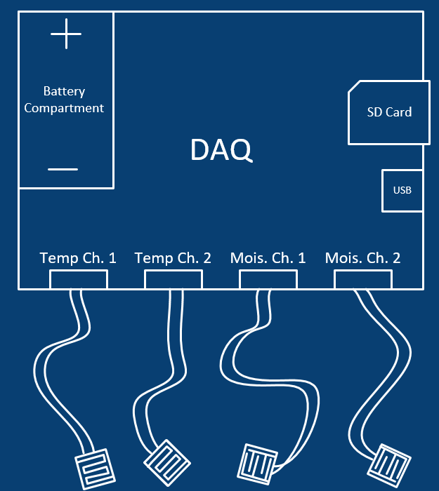
System Design
Weatherproof enclosure
Removable battery
4 Independent water resistant sensor connectors
USB streaming to PC for data analysis
Removable SD Card
Notes:
Presenter Nathan
Up next: Jacob

Slide 8
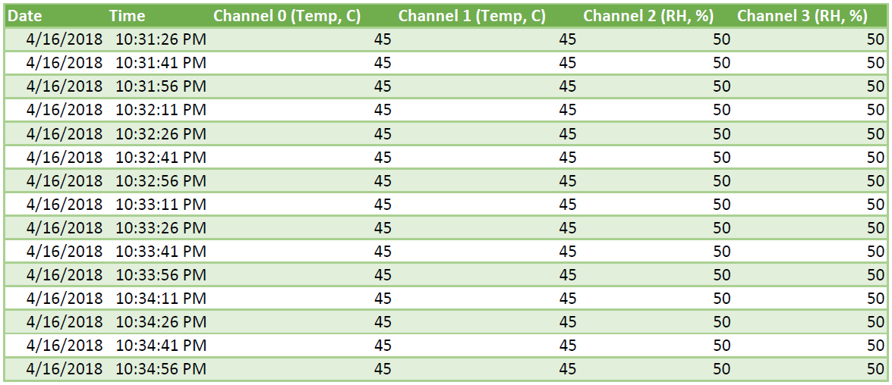
User Interface
Logs saved to CSV file on SD card
Each time the DAQ is reset, a new log file will be created
Displays date, time of measurement, and corresponding measurements
Figure: Sample Output Log File
Notes:
Presenter Jacob
Up next: Sok-yan

Slide 9
Deliverables
A functional and reliable DAQ system
Gather soil moisture and temperature throughout the course of month.
Sensor and DAQ module can be used outside in the harsh Iowa environment.
DAQ system must be able to last one month in an average climate.
In addition, we will be working in conjunction with Dr. Tuttle to recreate MEMS sensors for the DAQ system
Notes:
Presenter Sok Yan - include the sensors as well as the DAQ

Slide 10
Project Management
Weekly team meetings and work sessions were scheduled to keep the project on task
A Gantt Chart was created with major milestones for the project
A shared Google Drive folder was created for quick access to written team documents
Weekly status reports
Meeting minutes
Team meeting notes
Faculty advisor meeting notes
Notes:
Presenter Sok-yan

Slide 11
Project Milestones and Schedule
Tasks | Progress
Project Plan Final Version | Completed
Board Assembly | Testing phase: 90% completed.
Software Development : Resistance and Capacitance Readings | Resistance implemented. Capacitance in progress. 60% completed.
Design Document Version 2 | Completed
Sensor Recreation Materials and Requirements | Completed
Prototyping | 60% completed.
Requirement Verification / Testing | 30% completed.
Sensor Recreation | Logistics coordinated. Start fabrication first week of Fall 2018 semester.
Notes:
Presenter: Sok Yan

Slide 12
Risks
Drift over temperature
Low capacitance resolution
Cable parasitics
Unknown measurement ranges (sensors not available)
Future sensor characterization needed
Notes:
Presenter Sok-yan
Up next: Kyle

Slide 13
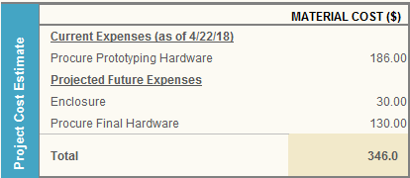
Resource/Cost Estimate
The cost estimate for our entire project is shown below
No labor costs
No specific budgetary constraints
Our goal was to spend no more than $500 during the duration of our project
Notes:
Presenter: Kyle
Next up: Nathan

Slide 14
Design Document
Notes:
Sok-yan
Up next: Nathan

Slide 15
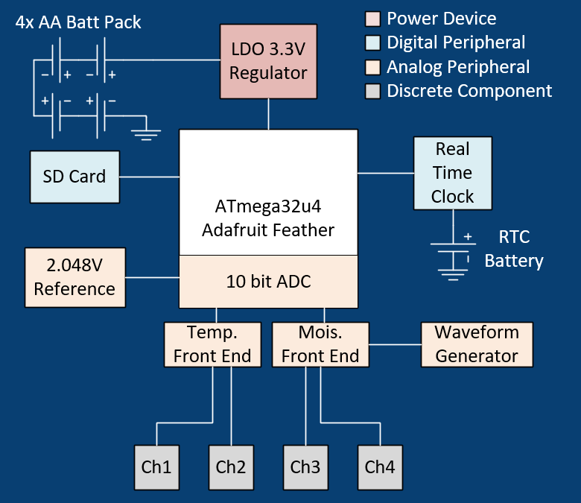
Technical Details: Hardware Architecture
Data storage on removable micro SD card
Four total sensor channels
Two temperature front ends (2mV resolution)
Two moisture front ends (40fF resolution)
Microchip ATMEGA32u4 Microcontroller
USB transceiver
10 bit ADC
Real-time clock for precise timestamp
External triangle wave generator
External ADC reference
2.048V 0.5%
4x AA Batteries
Notes:
Presenter Nathan

Slide 16
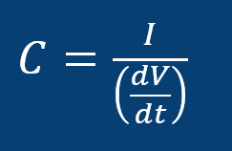
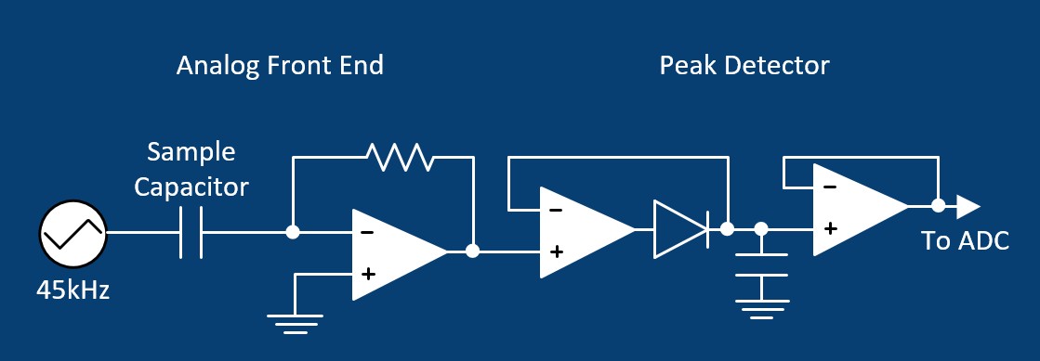
Detailed Design: Moisture Analog Front End
Two Stages
Current to voltage stage
Converts ~4uA current into 0-3.3V
JFET op-amp for ultra-low input bias current
Peak Detector stage
Sample and hold peak current for microcontroller
Schottky diode, low leakage capacitor, JFET op-amps
Notes:
Presenter Nathan

Slide 17
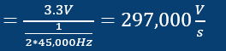
Detailed Design: Triangle Wave Gen
Triangle Wave
Constant slope (dV/dt)
Discrete Implementation
Generate square wave w/ 50% duty cycle
Integrate square wave
Our Implementation
MAX9000 application circuit
SOIC8 with internal comparator, voltage reference, and op-amp configured as integrator
Stable across temperature
Notes:
Presenter Nathan

Slide 18
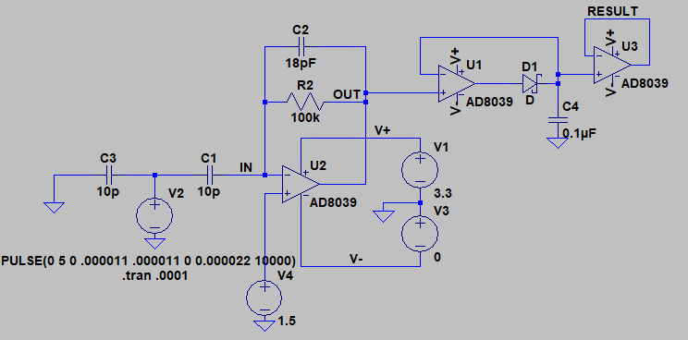
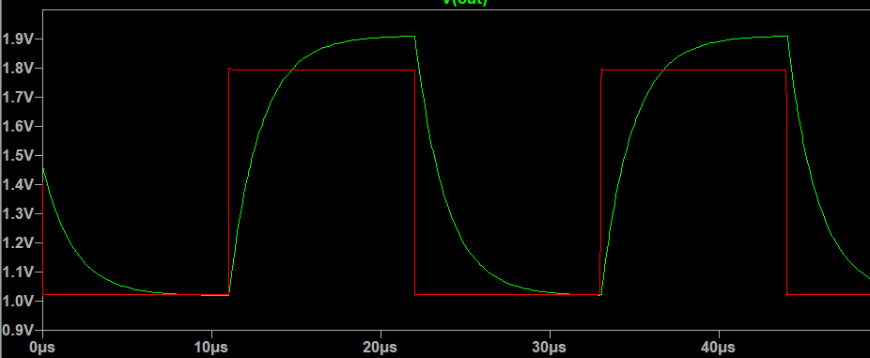
Basic Implementation: Hardware Simulation
Analog front end simulation in LTspice
Verified each input stage independently
Verified in hardware on bench
Identified issues with parasitics, preventative design in prototype
Breadboard prototype, perfboard prototype, now assembling first pcb prototype
Notes:
Presenter Nathan
Up next: Kyle

Slide 19
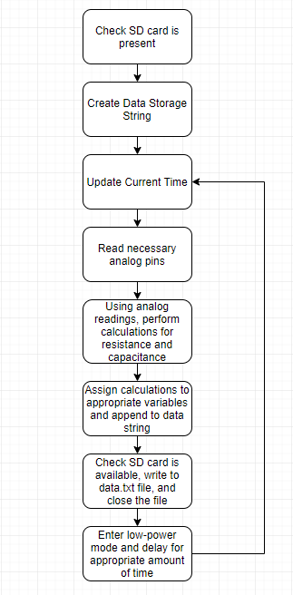
Detailed Design: Software
Software development has been done in the Arduino programming environment
Used standard libraries compatible with the Adafruit Feather 32u4 Basic Proto board
SPI.h
SD.h
Wire.h
RTClib.h
Notes:
Presenter Kyle
Up next: Sok-yan

Slide 20
Test Plans
All test plans are documented in our design document on the website
Would like to touch on specifically the resistance measurements of our DAQ system
More extensive test plans for each individual requirement listed in our design document
Notes:
Presenter: Jacob
-Jacob - talk about resistance measurements

Slide 21
Test Results
We have not had the chance to perform all the tests we would like
However, currently our project plan and design document articulate our testing plans and procedures
Some preliminary prototype results for measuring resistance values
We measured resistance at 30 data points between 10 and 1000 ohms, with an emphasis on values between 100 and 400 ohms.
The average difference between DMM readings and our DAQ readings was 0.4 ohms.
Temperature Testing
Notes:
Presenter Jacob
Next up: Nathan

Slide 22
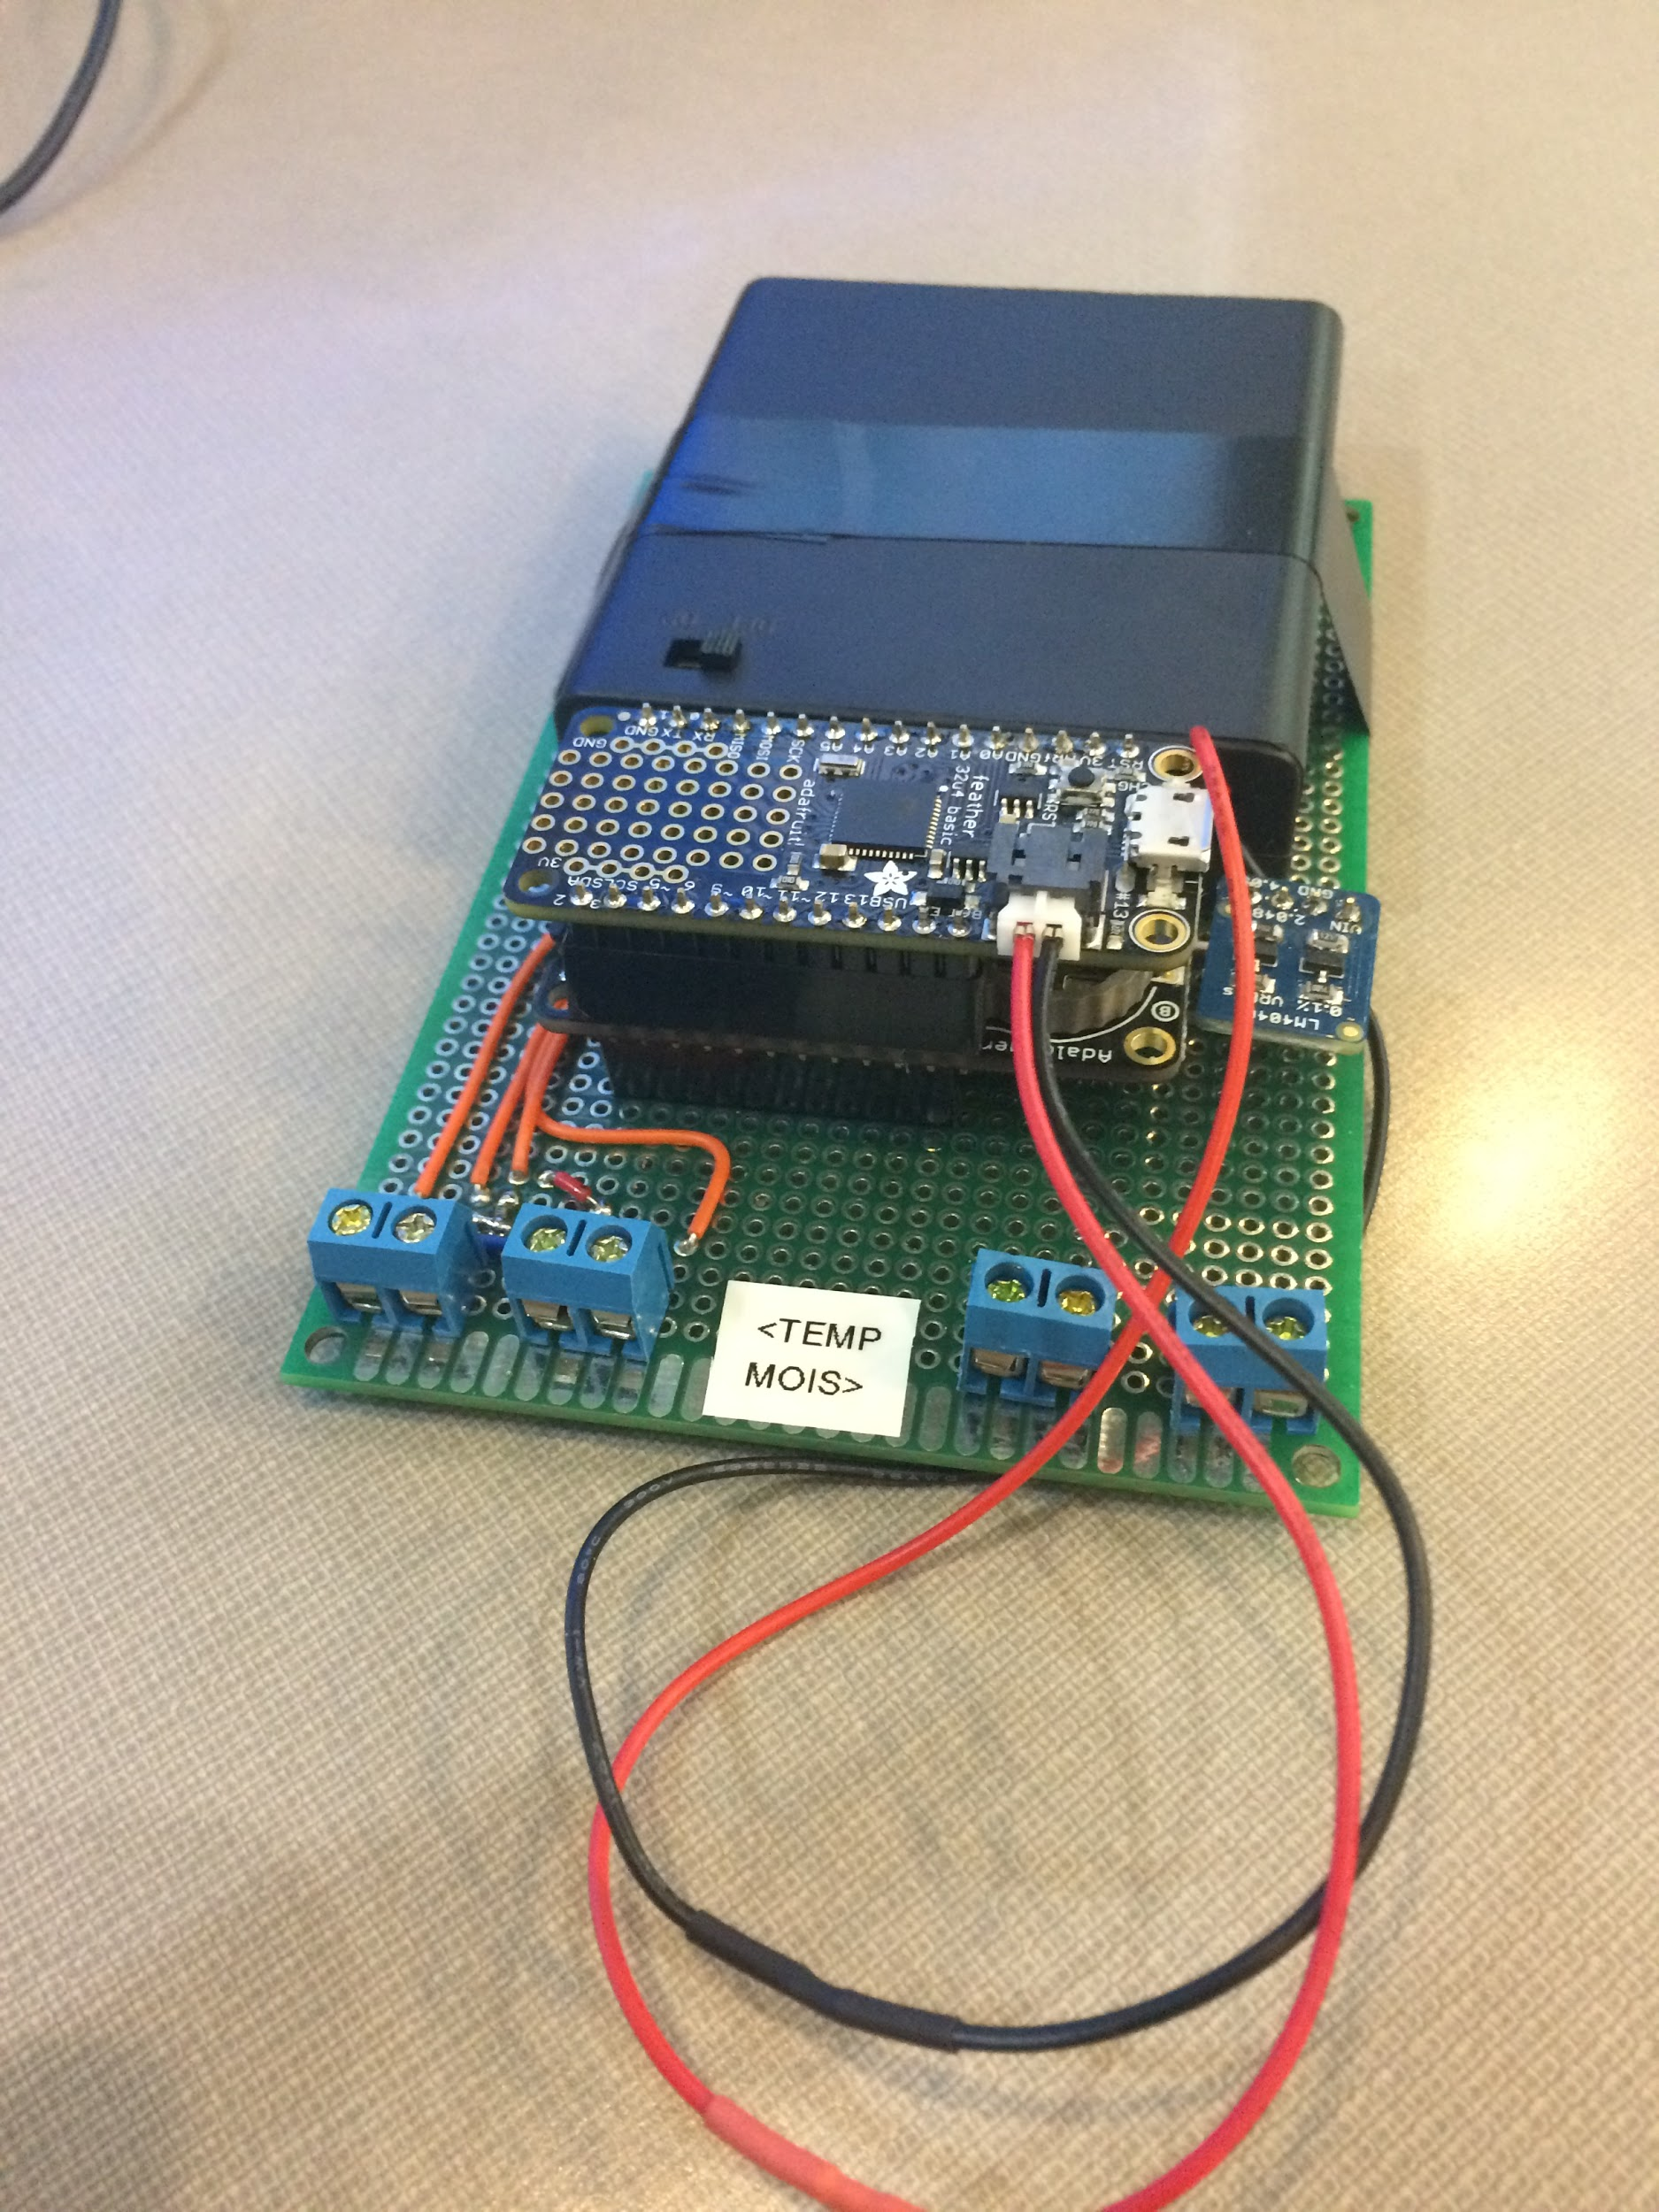
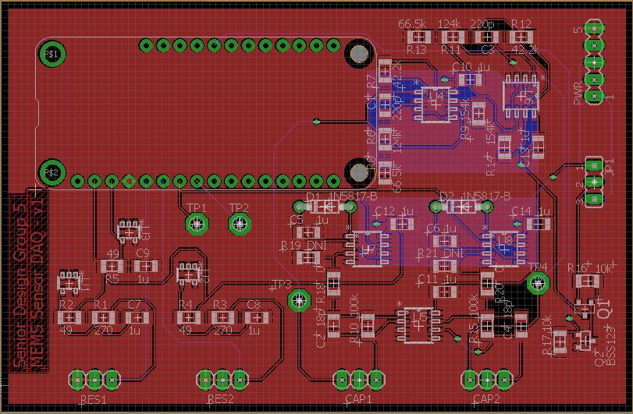
Prototype and Refined Board Design
Design Document - 8
Notes:
Presenters Nathan first and then David second

Slide 23
Conclusion
Conclusion - 0

Slide 24
Current Status & Plan for Fall Semester 2018
We are about finished with our third prototype
Tested resistance measurement circuitry
PSpice Simulations as well for capacitance measurement circuitry
Beginning next semester we will recreate sensors and continue with our more refined prototype along with implementing capacitance measurements
Conclusion - 1
Notes:
Presenter Kyle

Slide 25
Questions?
Conclusion - 2

Slide 26
Supplementary

Slide 27
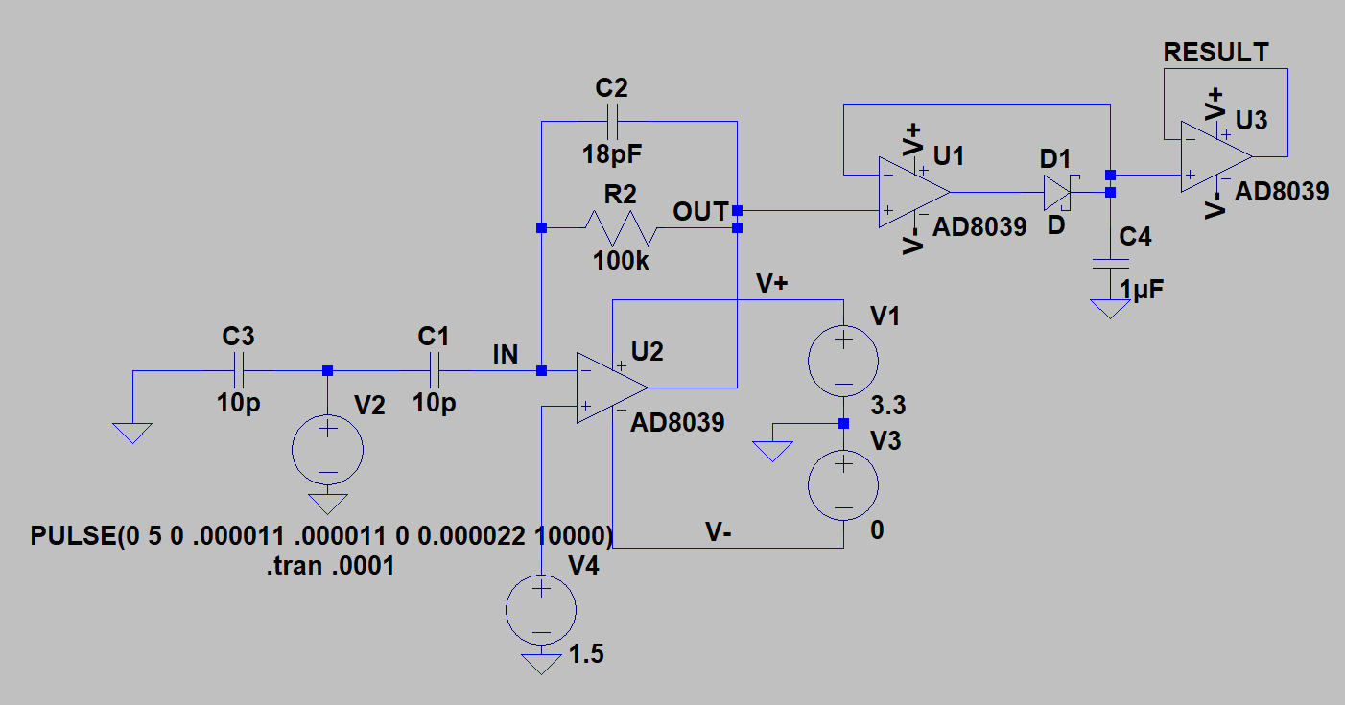
Supplementary

Slide 28
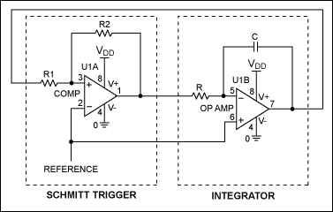
Supplementary

Slide 29
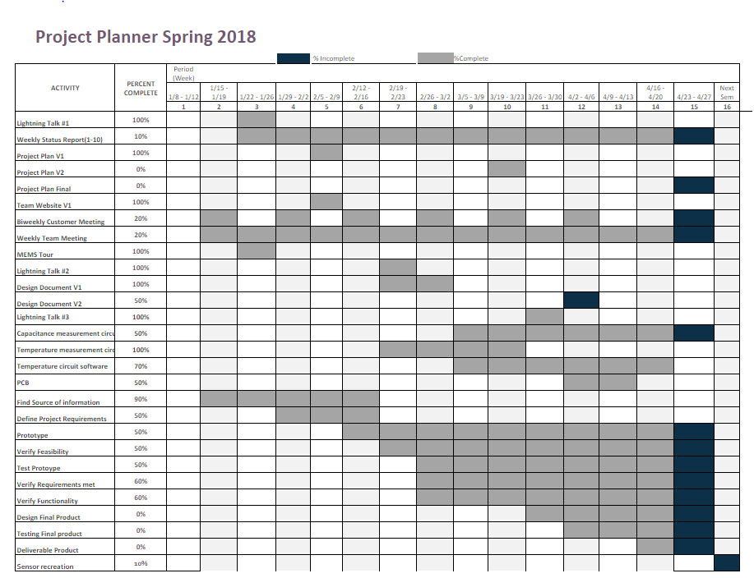
Supplementary

